Slide 1

Water Point Commitee (W.P.C)
This user guide will help you navigate to this console. And display the features available.

Slide 2
How to access the console?
Access the mWater portal.
Access the HANWASH portal.

Slide 3
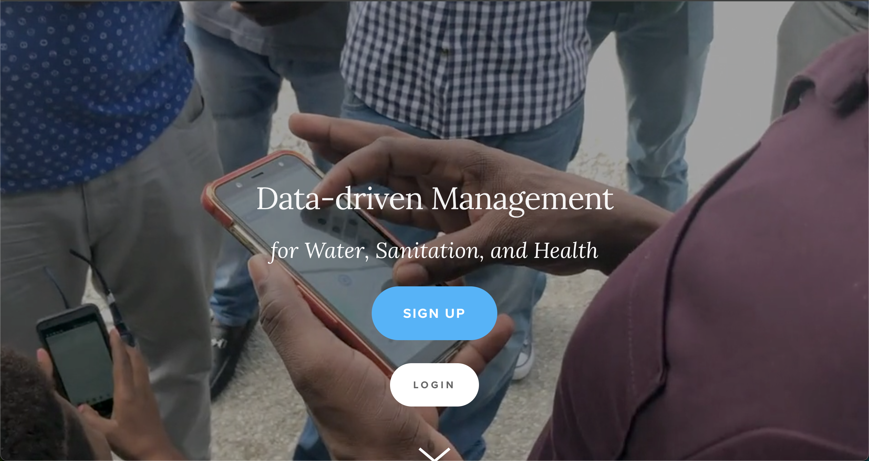
Mwater Home
URL LINK : https://www.mwater.co

Slide 4
Authenication PRocess
Click on the Login button.

Slide 5
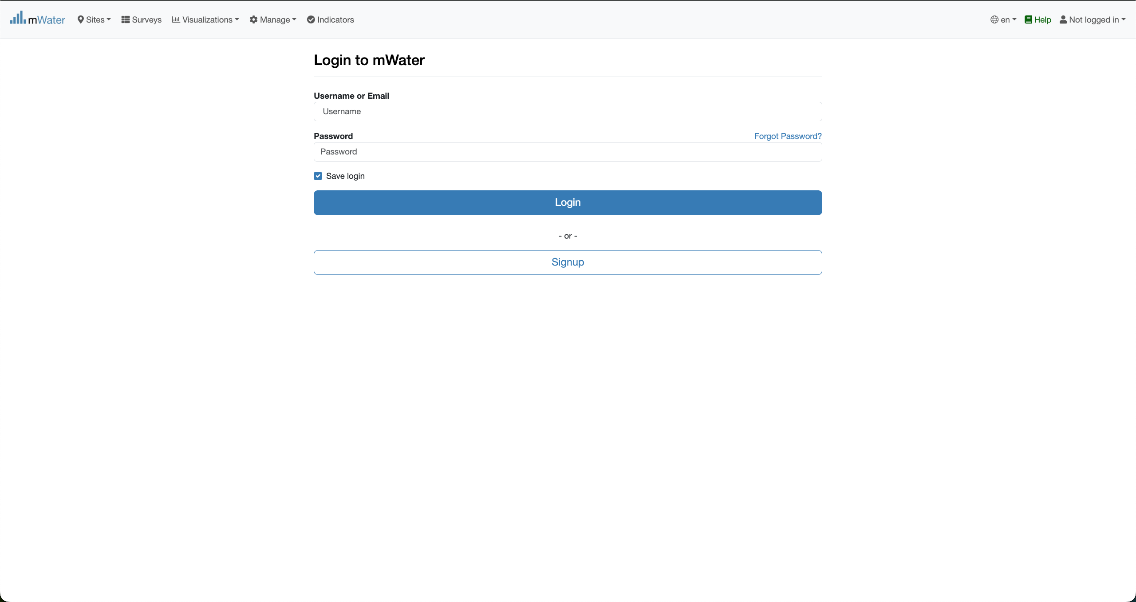
Authentication PRocess
You are not logged in.
Fill with your credentials and click on the log button.

Slide 6
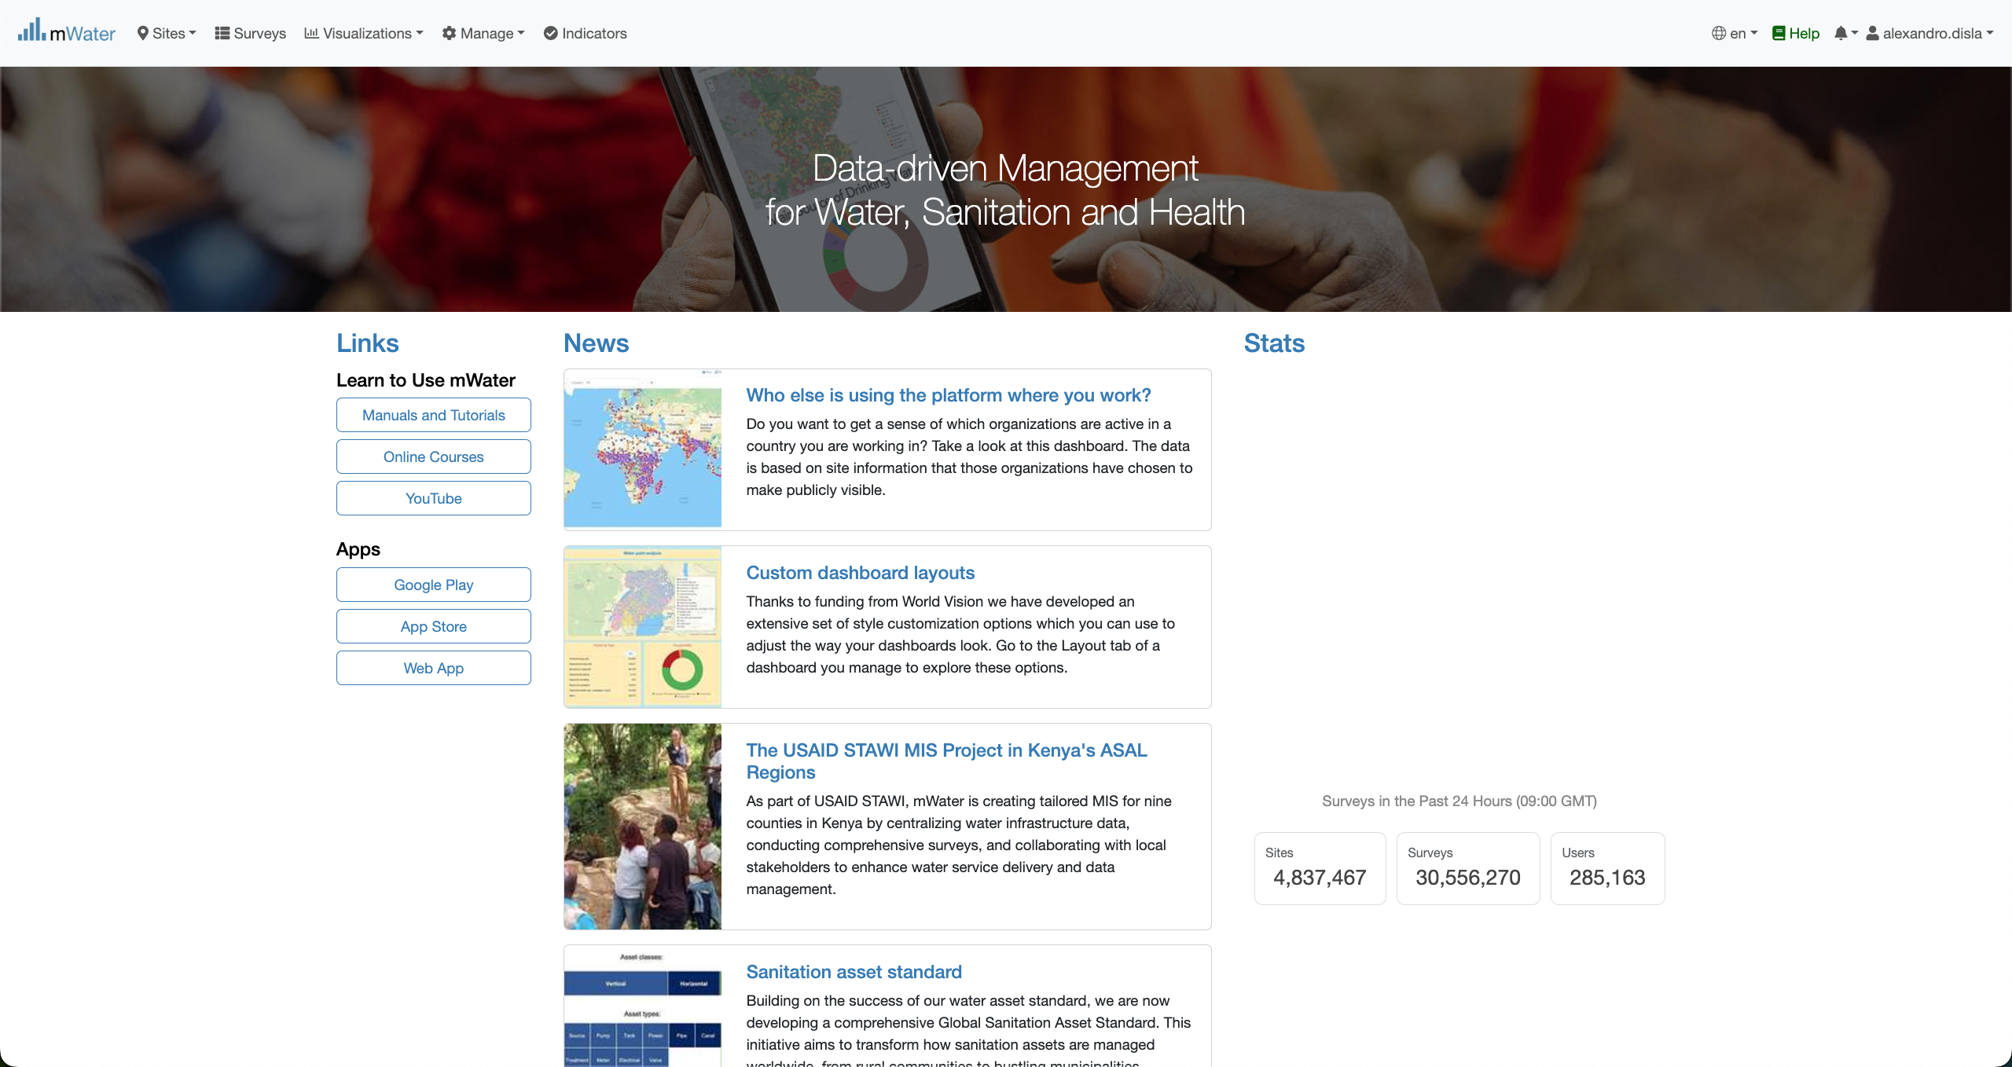
Mwater Home page Portal
You have successfully logged in.

Slide 7
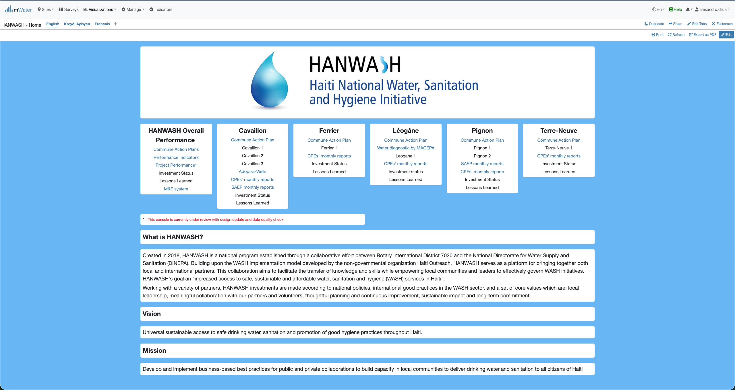
Hanwash HOME
After you have been logged in mWater. Please use this link in your browser to access the HANWASH HOME CONSOLE, quickly.
URL LINK : http://go.mwater.co/hanwash

Slide 8
Access the CPE CONSOLES
Please select the CPE Monthly reports, highlighted by their respective commune. The text in blue are clickable links

Slide 9
Console Overview
We have two page in the console. Please select the version of your pleasing.
1. CPE Reports (English Version)
2. Rapport CPE (French version)
Please stay on the CPE reports page.

Slide 10
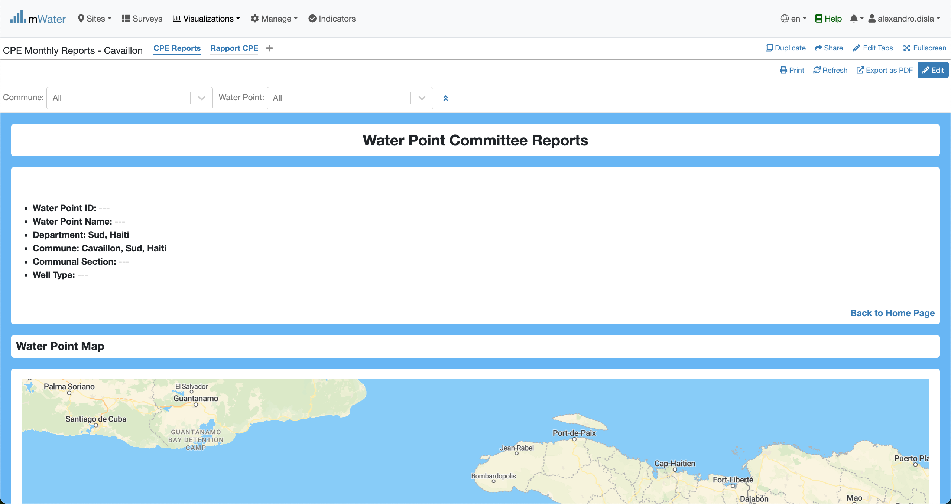
Console Overview
Please make sure that you are on the CPE Reports.
This will bring you back to HANWASH Home.

Slide 11
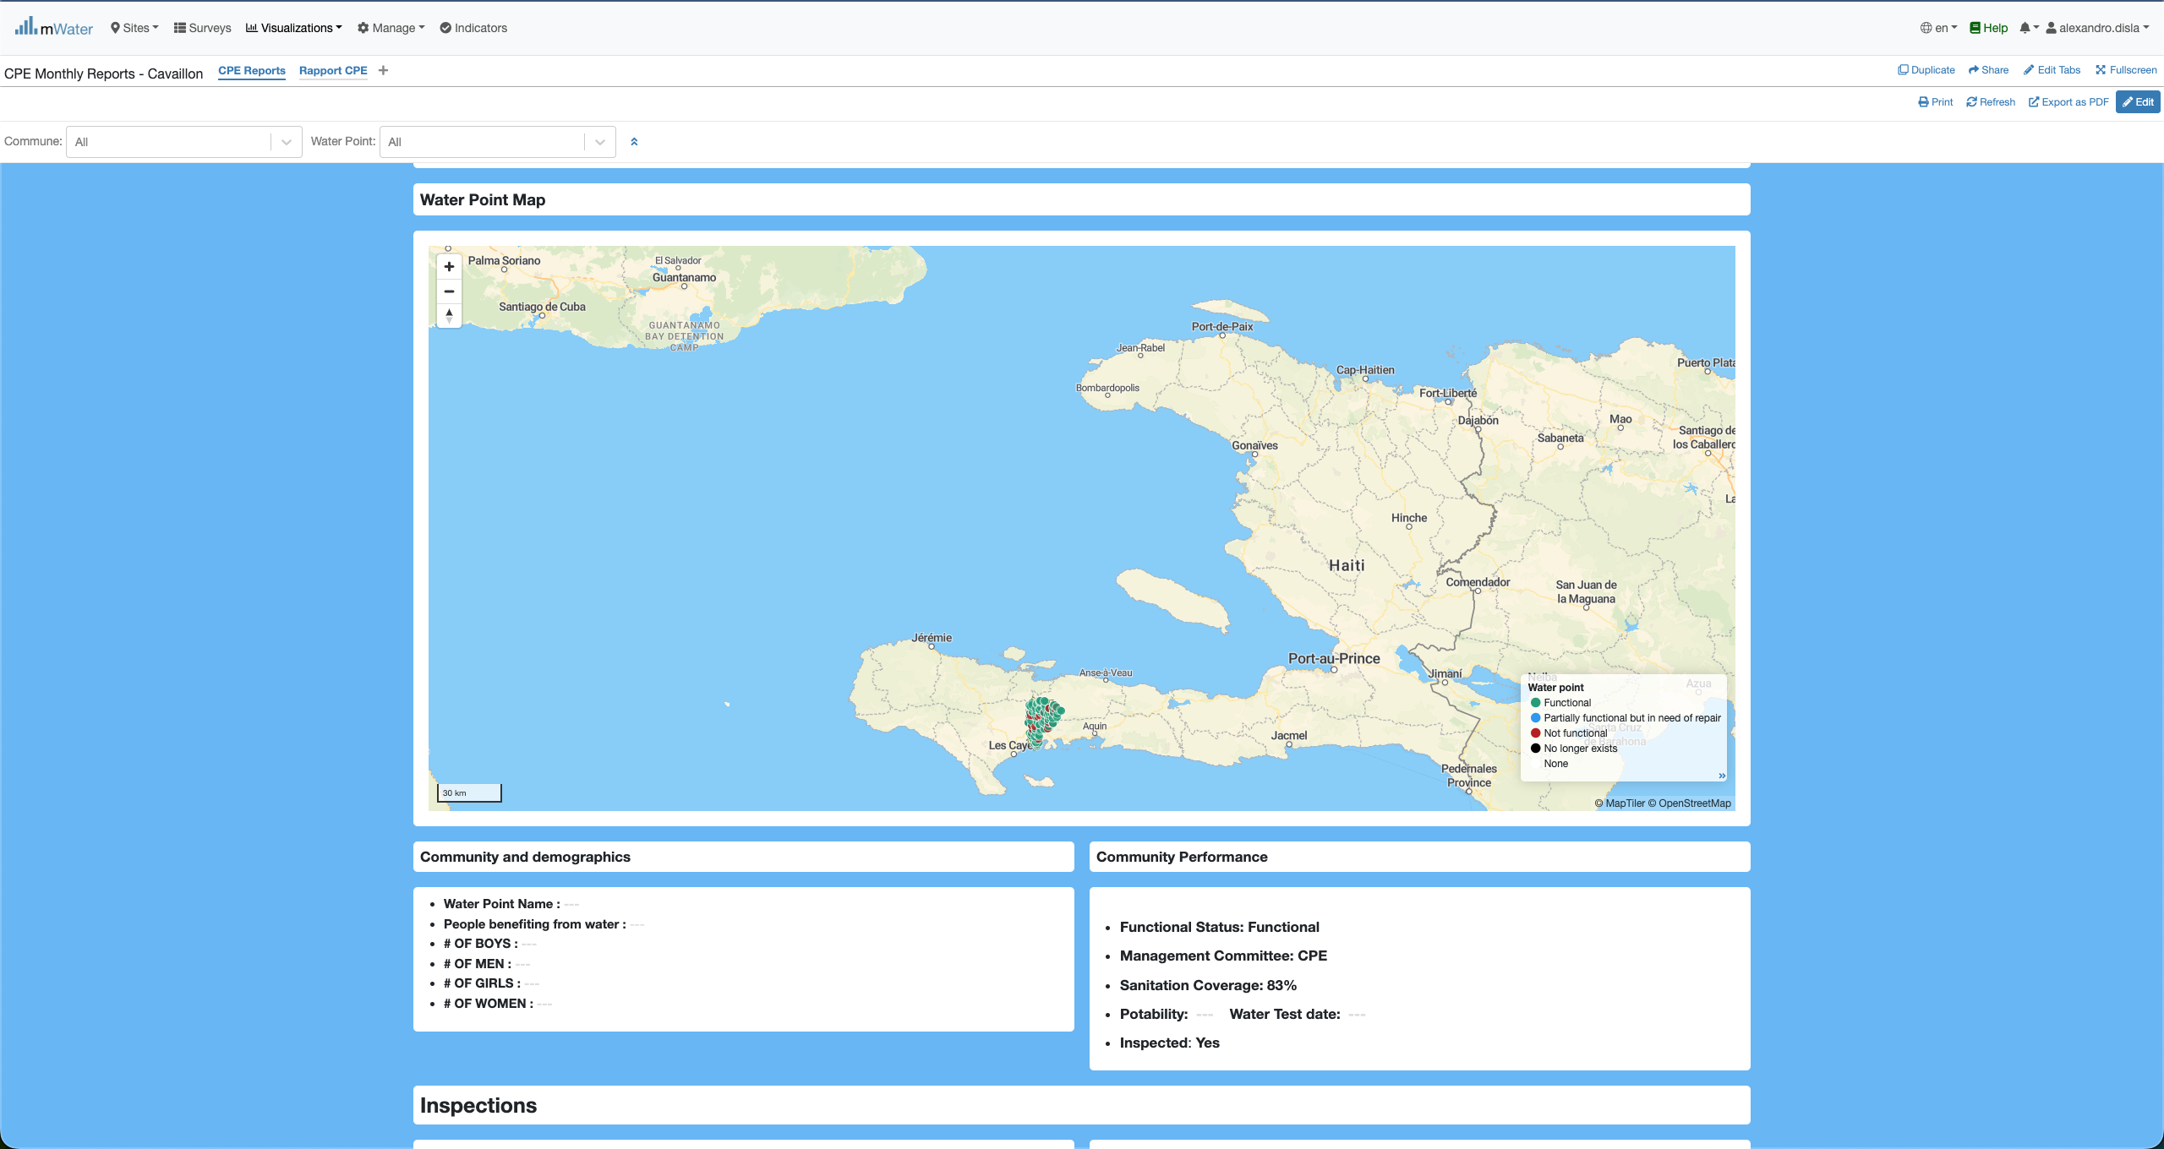
Console Overview

Slide 12
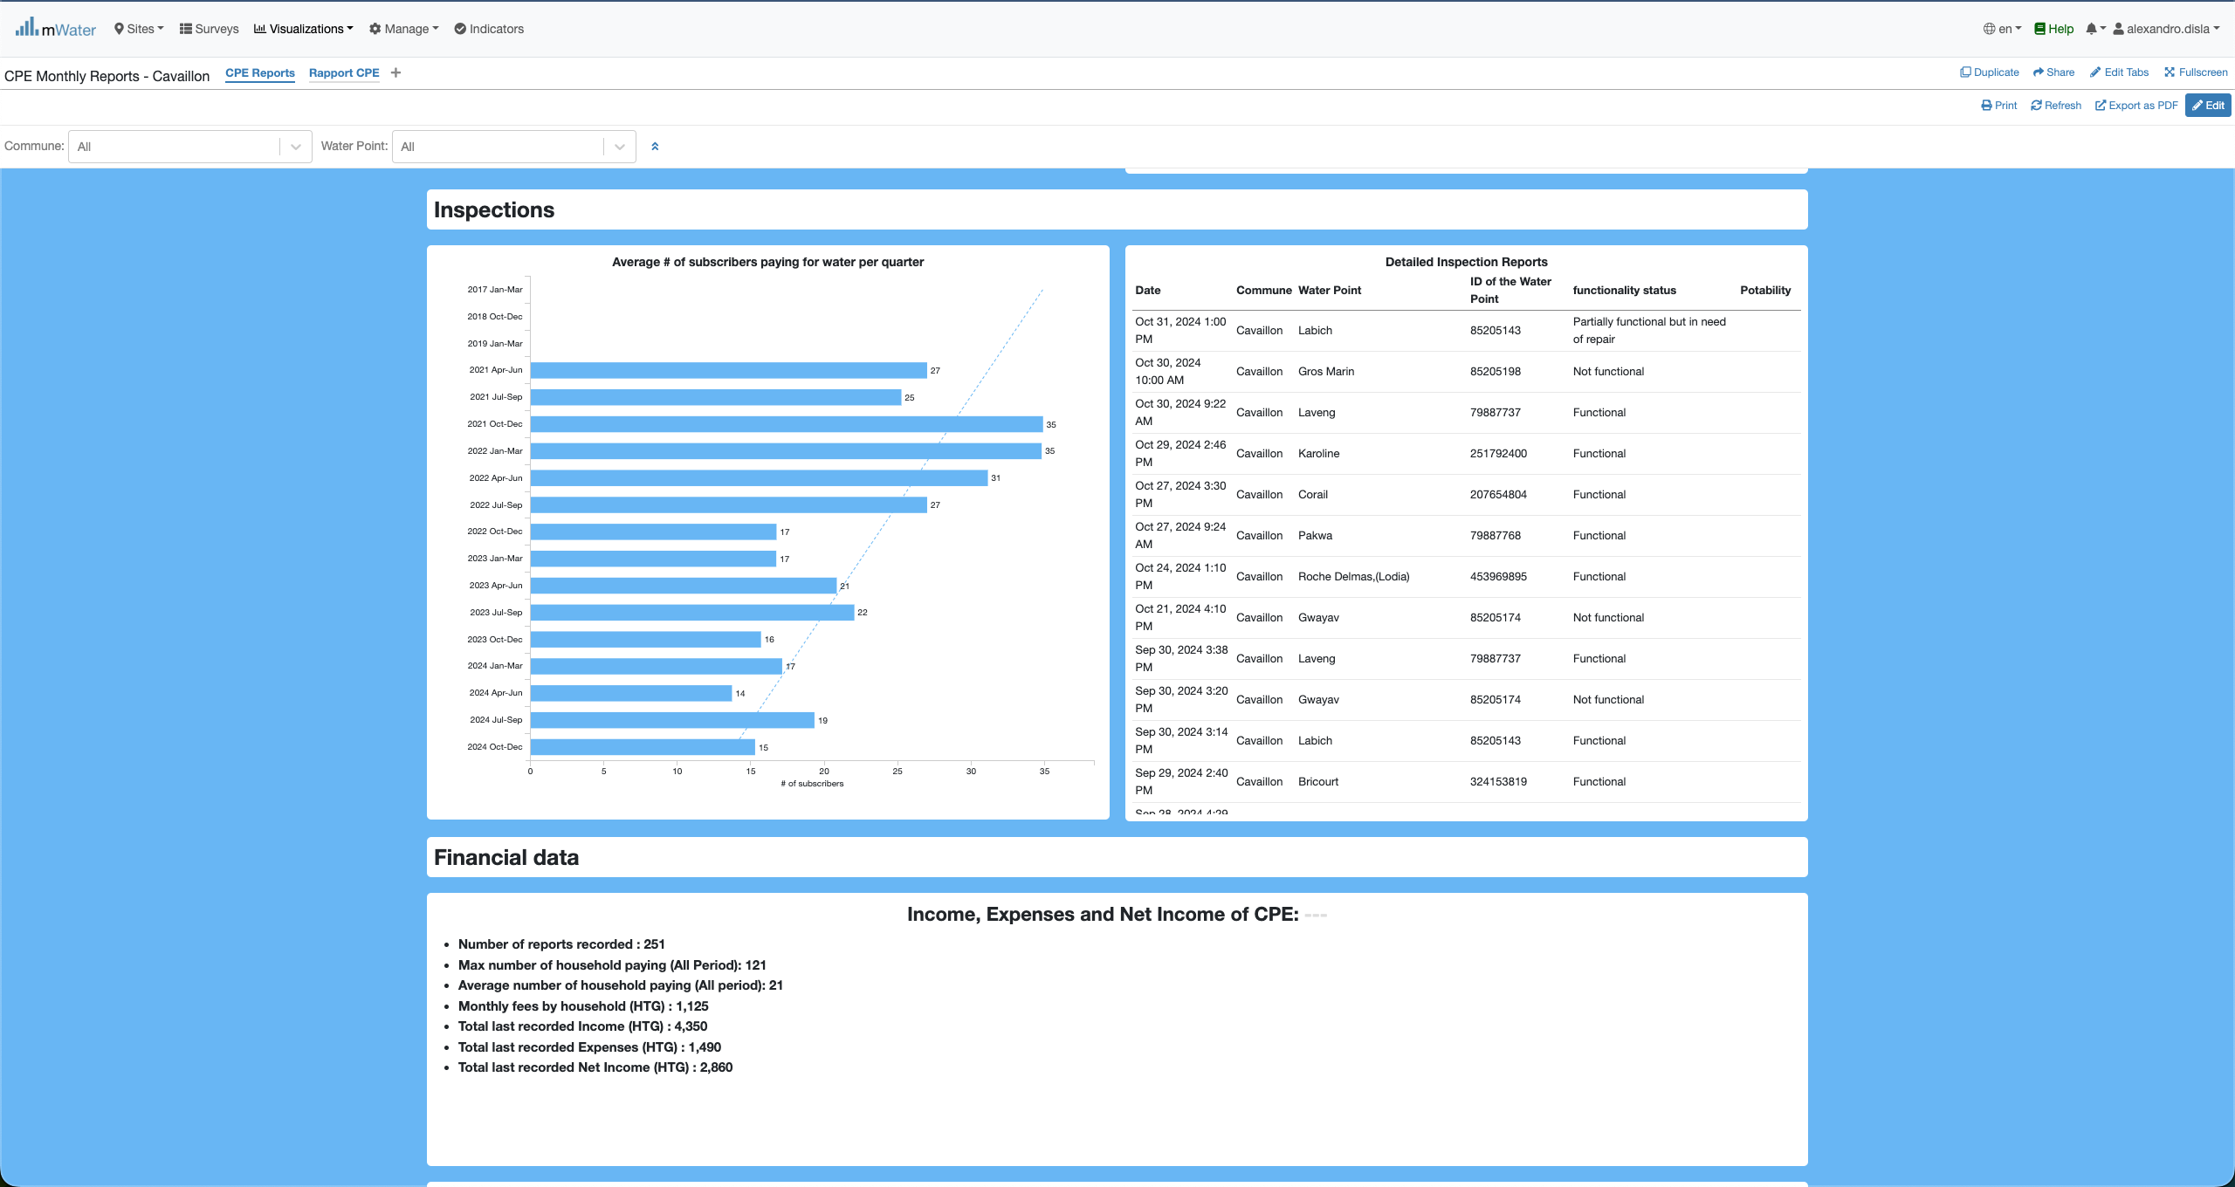
Console overview

Slide 13
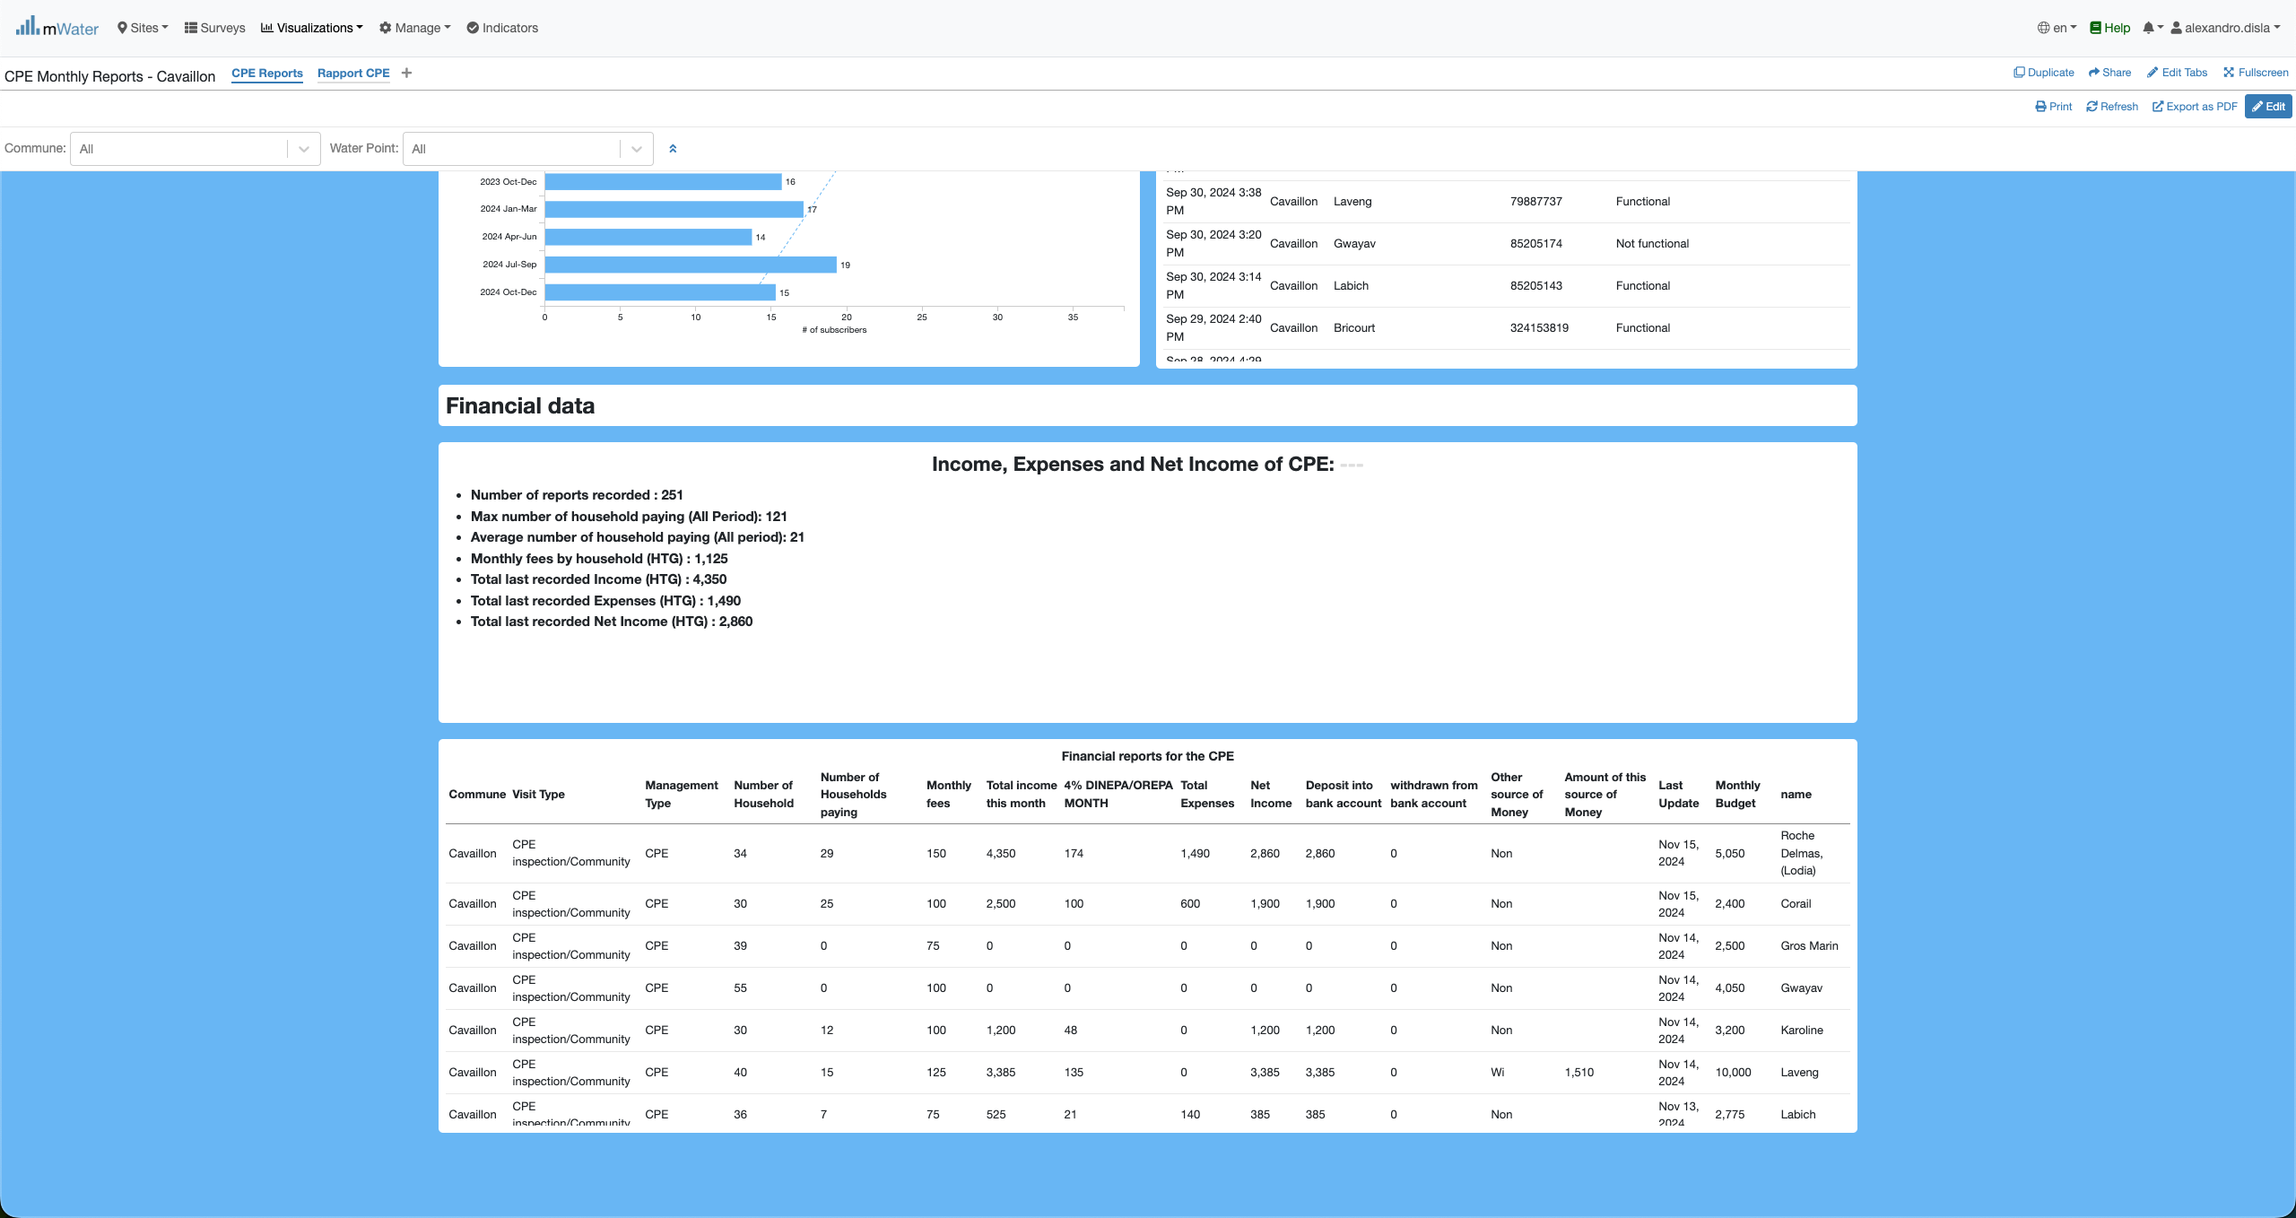
Console overview

Slide 14
Functionalities
What are functionalities available?

Slide 15
CPE REPORTS
CPE Reports:
Header Section
Map Section
Community demographics & performance Sections
Inspections Section
Financial Section

Slide 16
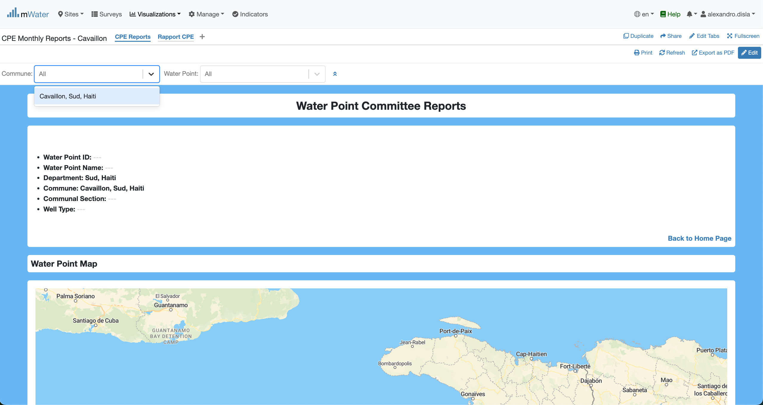
Header & QuickFilters
By design this console is fixed for the commune of Cavaillon.

Slide 17
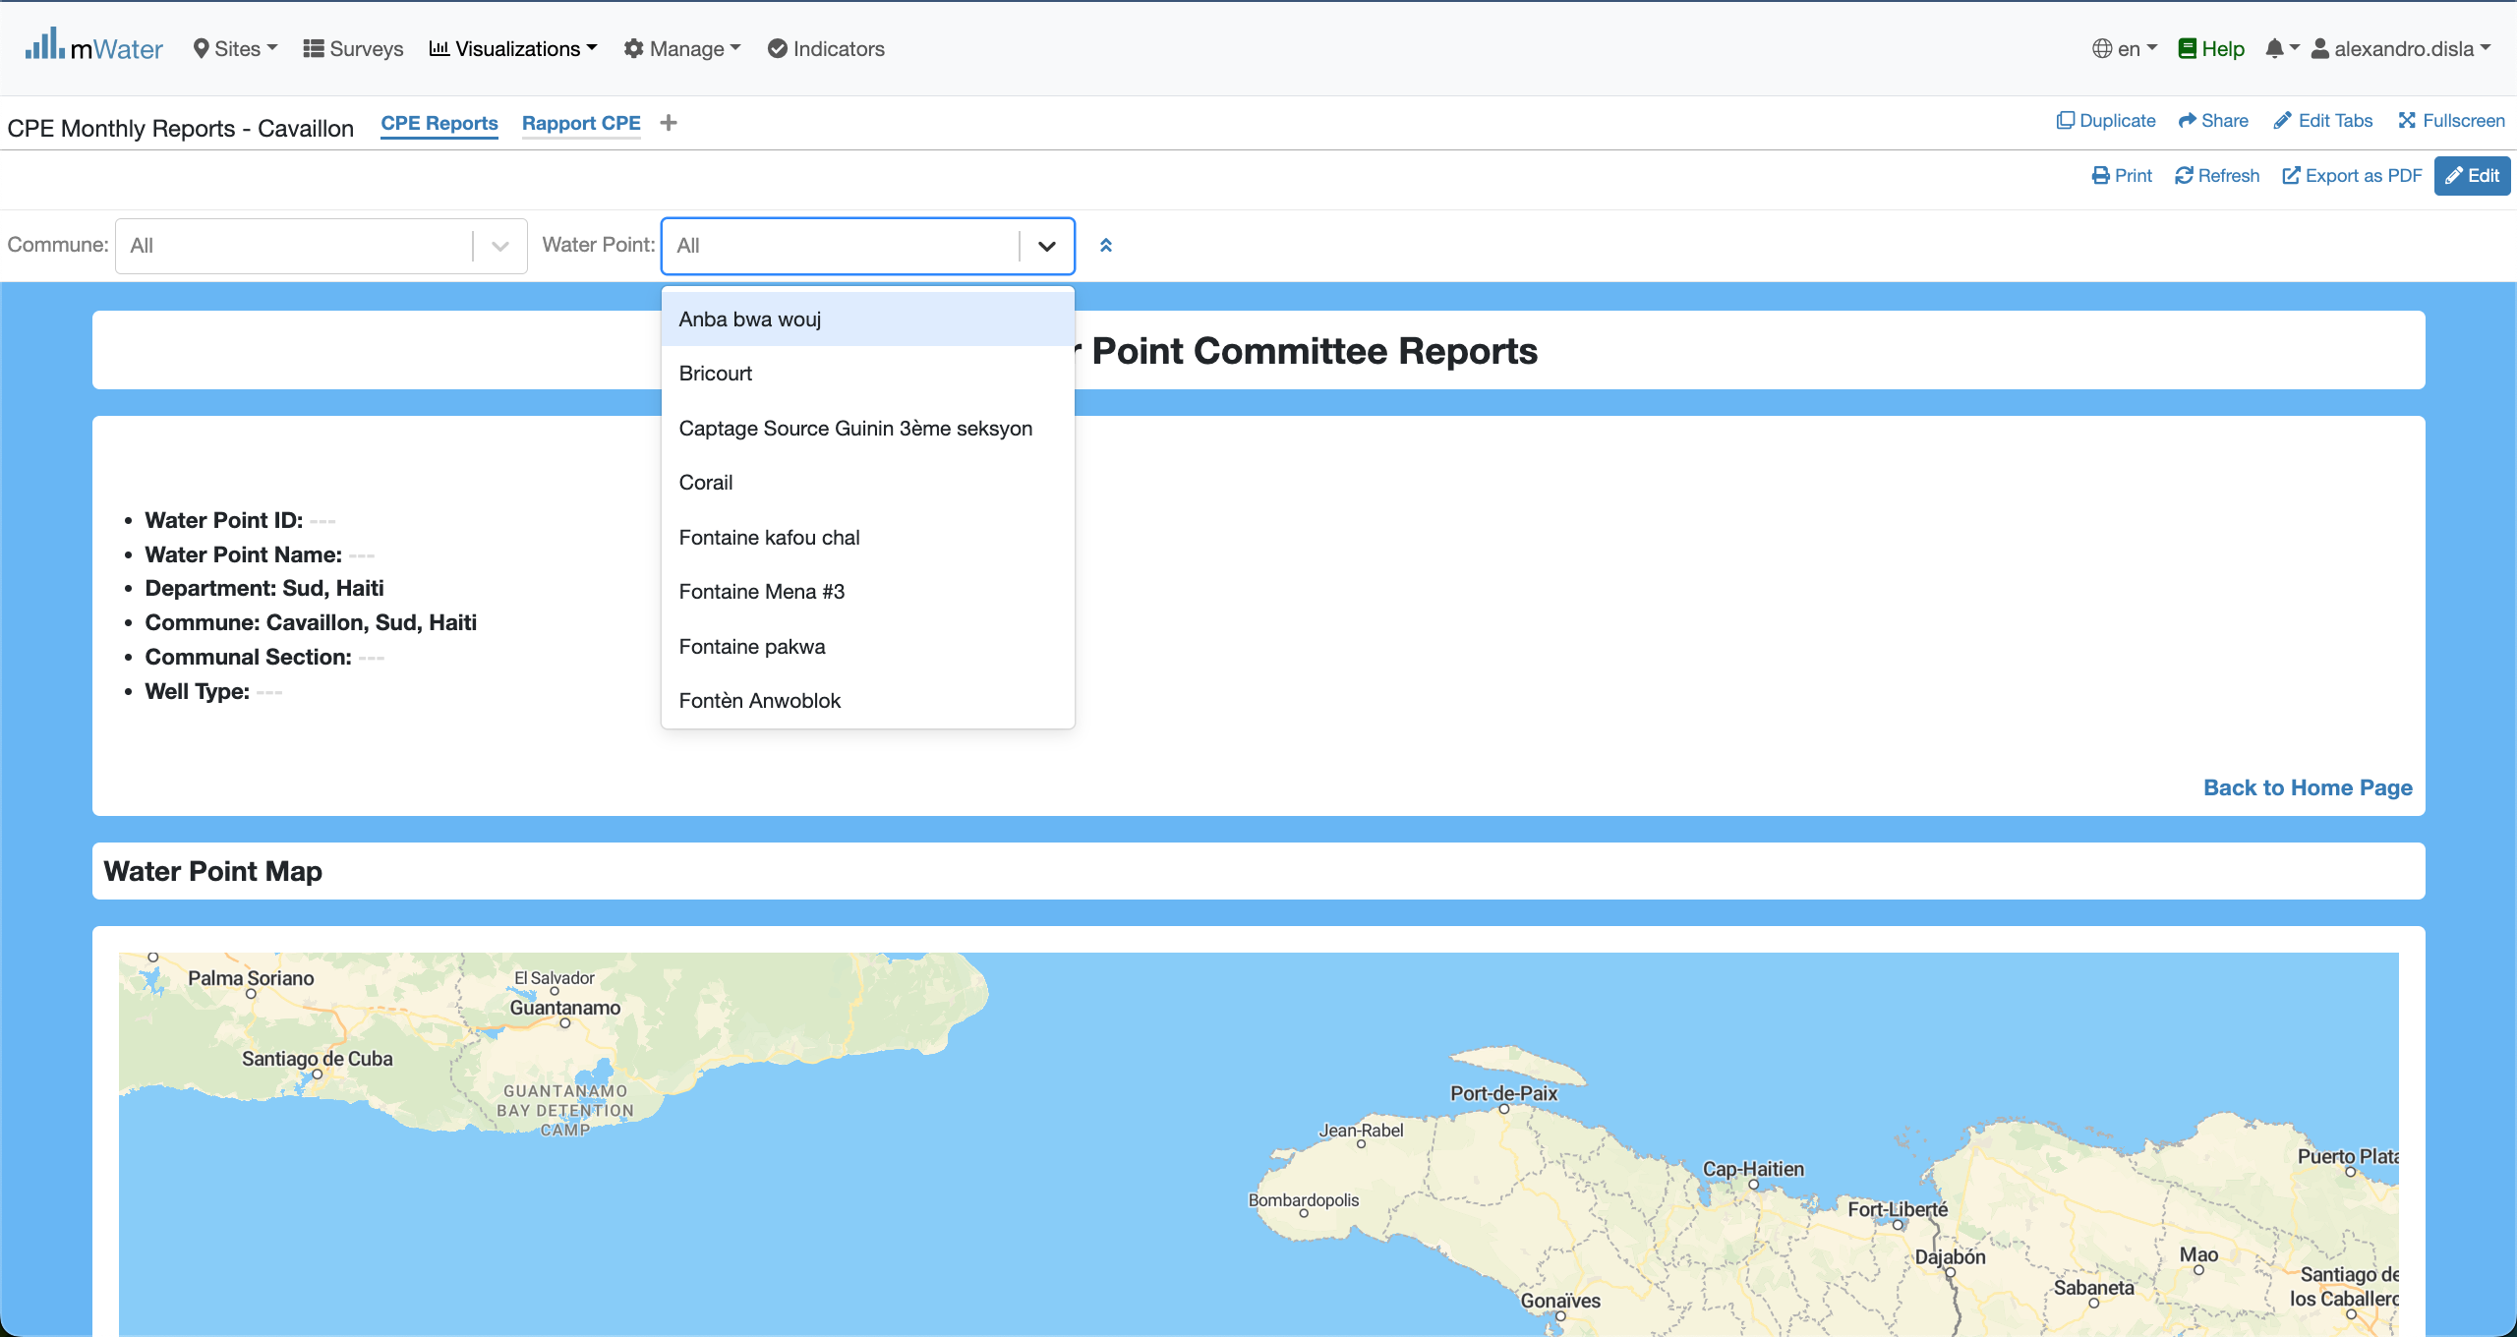
Header & QuickFilters
The water quick filter will display the name of the water points registered.

Slide 18
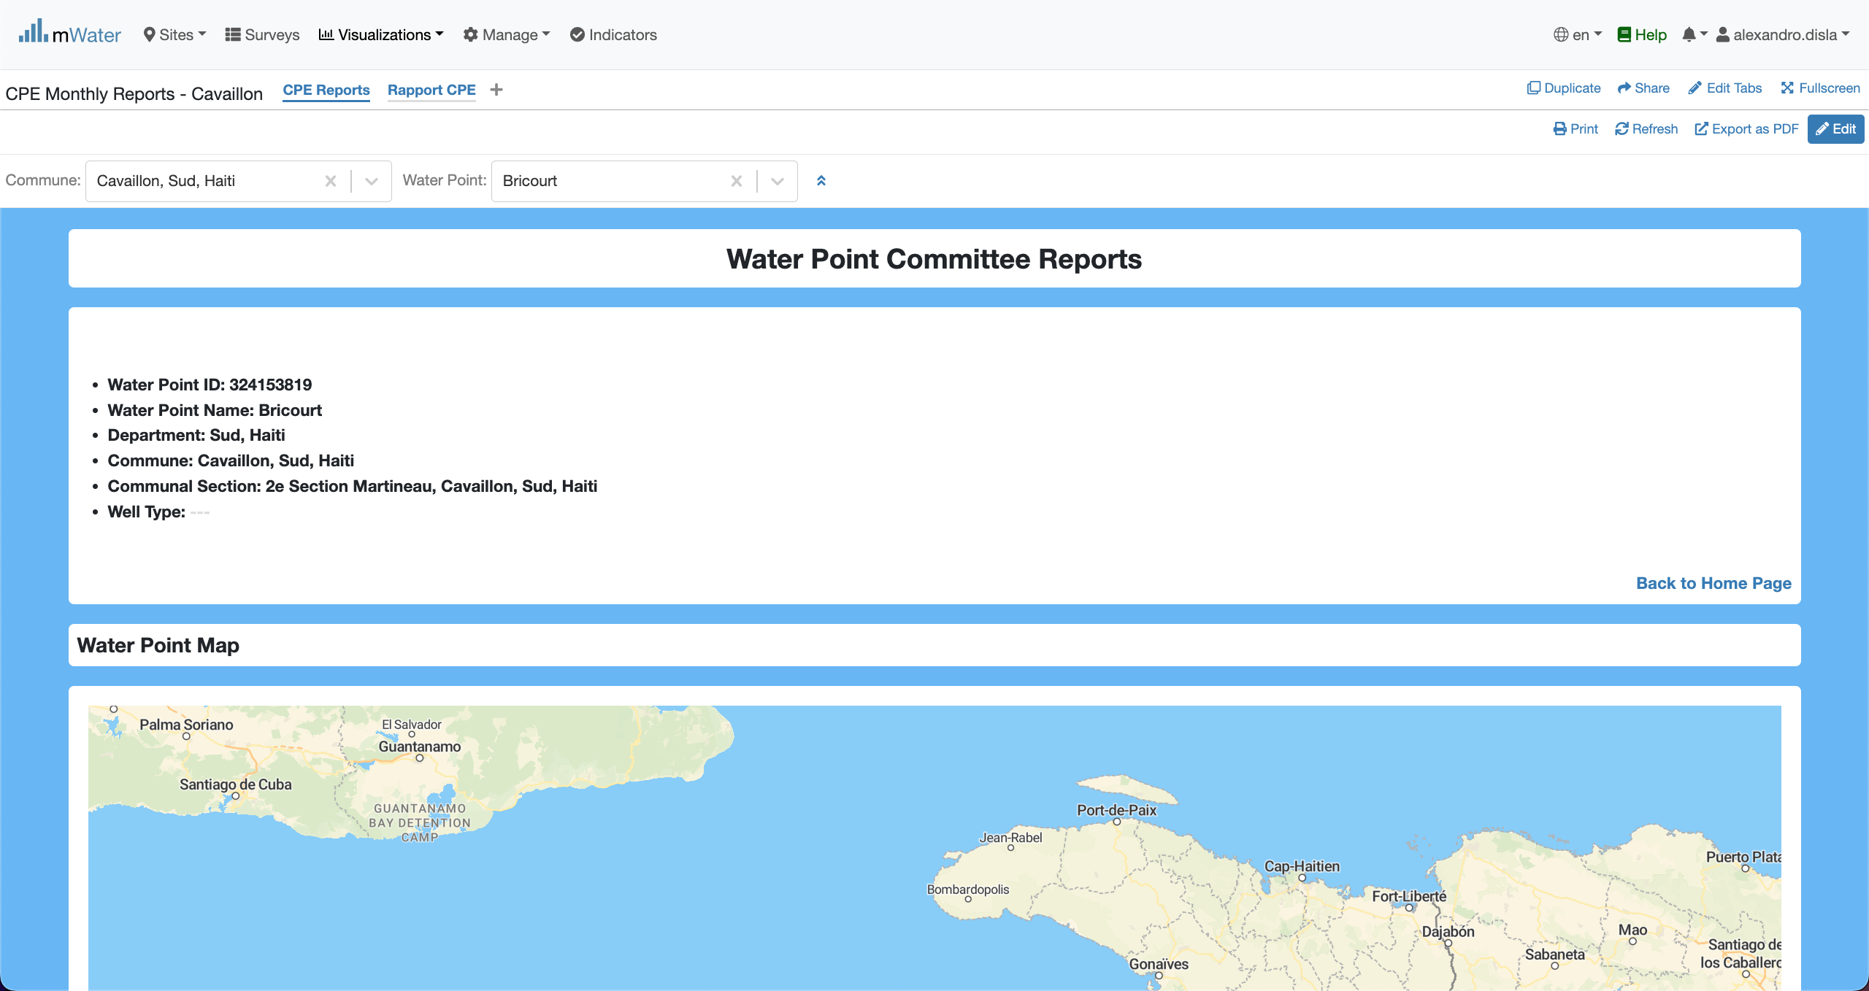
Display data in the console
With the quick filter active, the data will fill each section of the console. The header section display the common general information about the Water point.

Slide 19
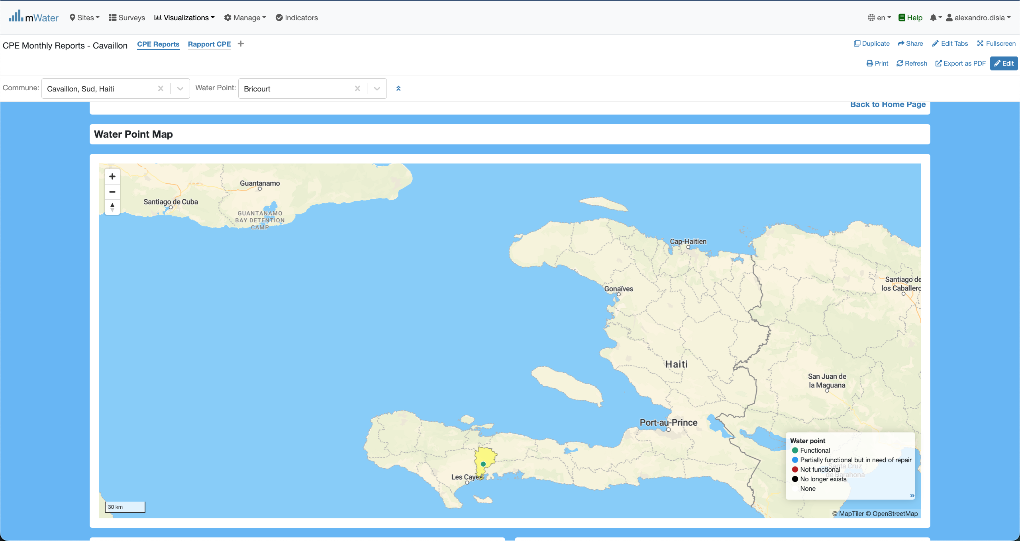
The MAP section

Slide 20
Export

Slide 21
Thank You !!!
PLEASE FEEL FREE TO CONTACT ME BY :
Email / alexandro.disla@hanwash.org
Whatsap or Phone / +50941483700

